Slide 1
CLAS 220: Introduction to Classical Mythology
Lecture 4: Heroes
Philostratus, Heroikos

Slide 2
Quiz Question
What is the name of the hero buried near Troy who is discussed in the Heroikos?
Philomela
Protesilaus
Philoctetes
Penthesilea

Slide 3
Quiz Question
2. Which of the following groups does Protesilaus help?
Athletes
People with eye diseases
Young couples in love
All of the above

Slide 4
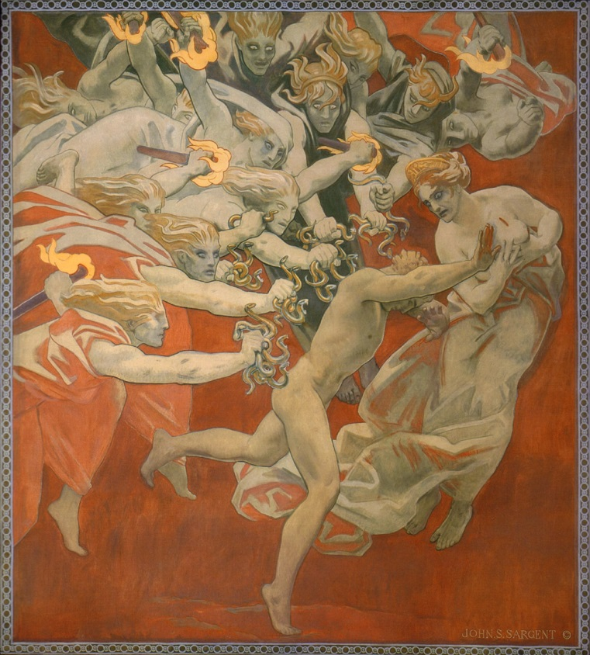
Olympian and Chthonic Deities
Olympian: to do with the heavens, and what is above the earth
Chthonic: to do with what is beneath the earth (chthôn = earth); with death and fertility
Olympian deities:
the twelve Olympian gods
Chthonic deities:
Demeter/Persephone (sometimes)
Dionysus (sometimes)
Hades (always)
the Furies
heroes

Slide 5
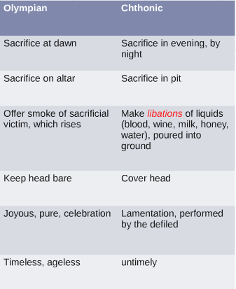
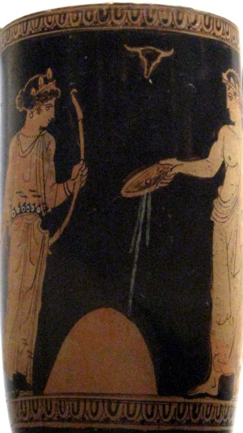
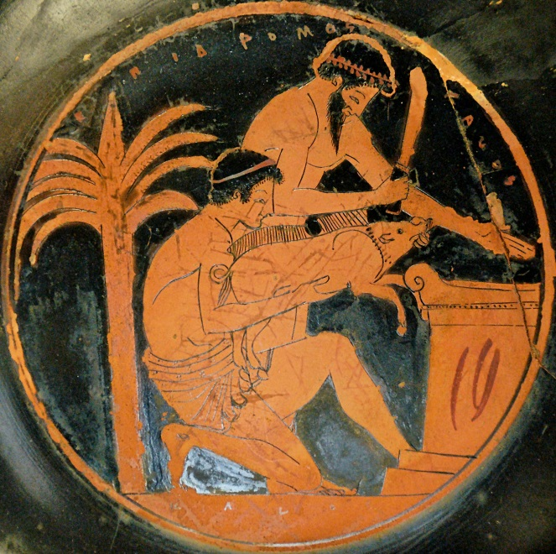
Olympian and Chthonic Deities

Slide 6
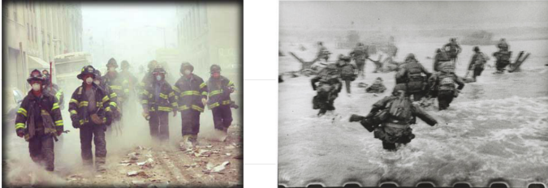
What is a hero?

Slide 7
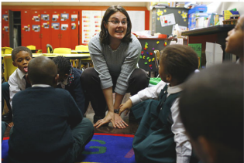
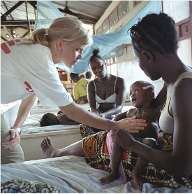
What is a hero?

Slide 8
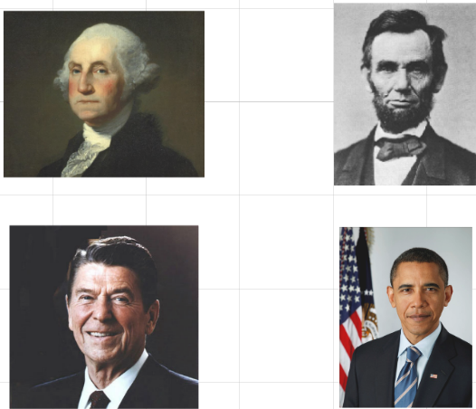
What is a hero?

Slide 9
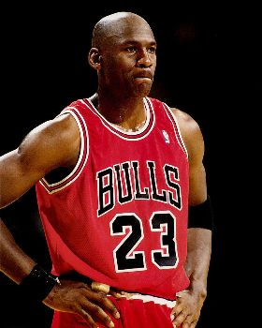
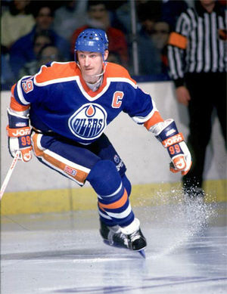
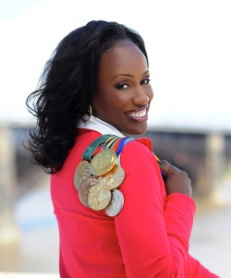
What is a hero?

Slide 10
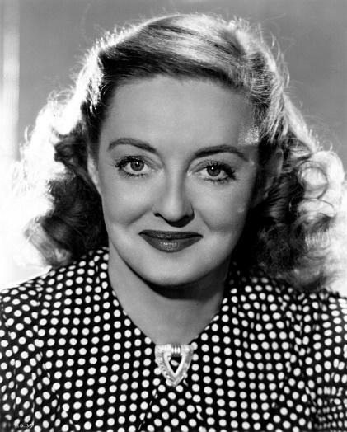
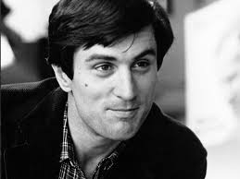
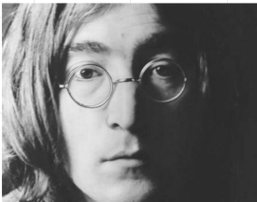
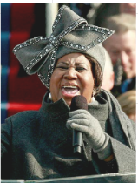
What is a hero?

Slide 11
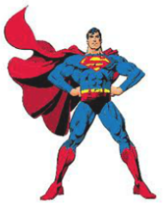
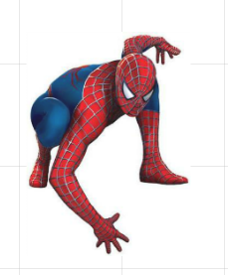
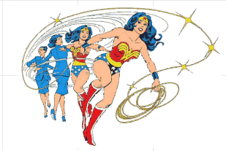
What is a hero?

Slide 12
What is a Greek hero?
Unseasonal
Extreme
Antagonistic relationship with a god

Slide 13
What is a Greek hero? 1. Unseasonal
μὴ φῦναι τὸν ἅπαντα νικᾷ λόγον: τὸ δ᾽, ἐπεὶ φανῇ,
βῆναι κεῖθεν ὅθεν περ ἥκει,
πολὺ δεύτερον, ὡς τάχιστα.
(Sophocles, Oedipus at Colonnus, 1225-27)
Not to have been born is the best of all by far; next best, by far,
Once born, is to go back whence one came
As soon as possible.

Slide 14
What is a Greek hero? 1. Unseasonal
ὥστε θνητὸν ὄντα κείνην τὴν τελευταίαν ἰδεῖν
ἡμέραν ἐπισκοποῦντα μηδέν᾽ ὀλβίζειν, πρὶν ἂν
τέρμα τοῦ βίου περάσῃ μηδὲν ἀλγεινὸν παθών.
(Sophocles, Oedipus the King, 1528-30)
Thus call no one who is mortal happy (olbios), none who is
Awaiting his final day, till
He reaches the limit of his life suffering no pain.

Slide 15
What is a Greek hero? 1. Unseasonal
Olbios:
Happy
Blessed
So:
Don’t count a man as happy until he has had a good death.
Don’t count a man as blessed (worship him as a hero) until he has had a good death.

Slide 16
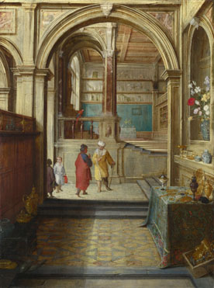
More on being olbios The Story of Solon and Croesus
Herodotus, Histories.
Solon, the founder of the Athenian constitution, and the wisest man in Greece, comes to visit the wealthy tyrant Croesus. Croesus asks Solon who the happiest (most olbios) of men is, expecting that the answer will be Croesus himself.
Solon’s answer: Tellus of Athens, who had “both beautiful and good children, and he saw all his grandchildren from birth and all remaining alive... And the end of his life was most brilliant: for when the Athenians had a war against their neighbors in Eleusis, coming to the rescue and making a rout of the enemy he died most beautifully, and the Athenians had buried him publicly right where he fell, and honored him greatly.”
Croesus then asks, “Who’s the second-happiest of men?,
feeling certain that, since he wasn’t #1, he’ll at least be #2.

Slide 17
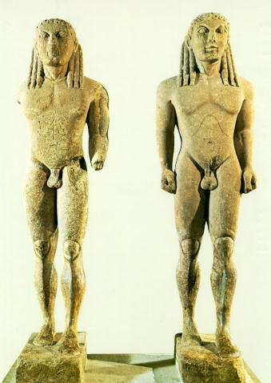
Solon and Croesus
… but he isn’t. Instead, the second-happiest of men are Cleobis and Biton, two young brothers who pull a chariot for their mother, a priestess of Hera, when the oxen who are supposed to do the job show up late.
She’s proud of them, and prays for the best thing that can happen to a mortal to happen to them. She gets her wish:
they lie down as if to sleep, and never get up.

Slide 18
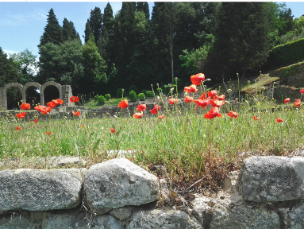
The lesson?
Life is brief, and full of suffering.
We’re like flowers that fade.
Fame after death is like a flower that never fades
κλέος ἄφθιτον
kleos aphthiton
fame that does not wilt

Slide 19
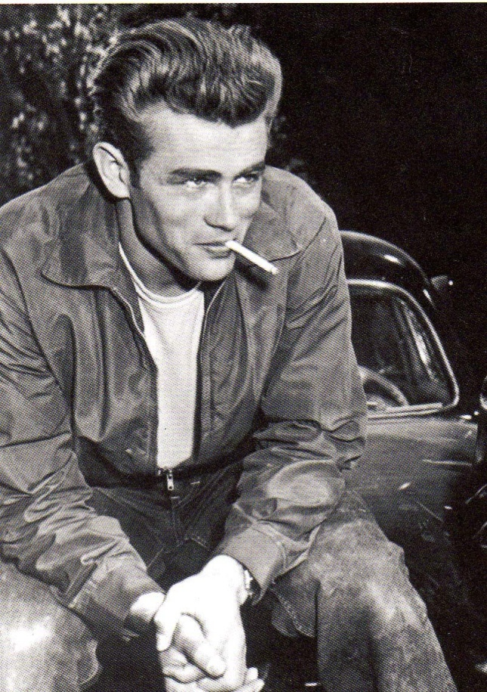
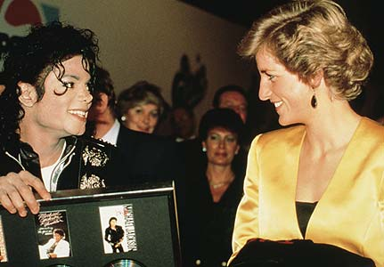
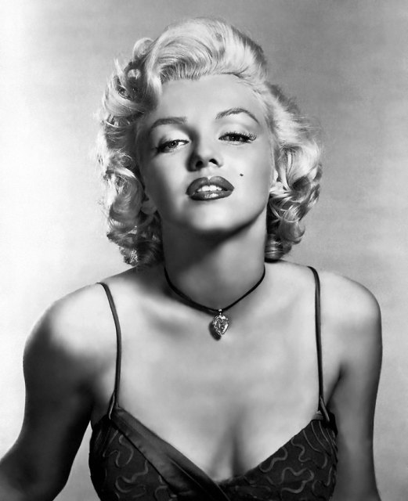
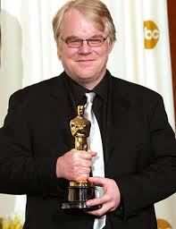
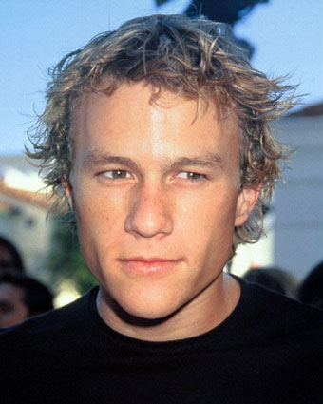
Unseasonal Heroes

Slide 20
κλέος ἄφθιτον
kleos is
fame
songs and stories about that fame (i.e. epic poetry)
worship as a hero
In the Greek world, it’s the one way to outlast death.

Slide 21

“His name is Robert Paulson.”

Slide 22
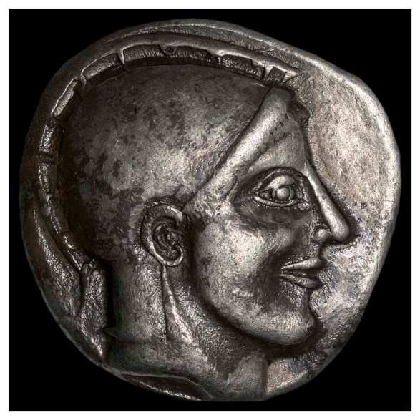
Philostratus, Heroikos
written in the early 3rd century AD
a dialogue between a Phoenician traveler and a vinedresser who works at the tomb of Protesilaus
Protesilaus was a young man, just married, who is the first Greek soldier off the ships at Troy, and the first to die

Slide 23
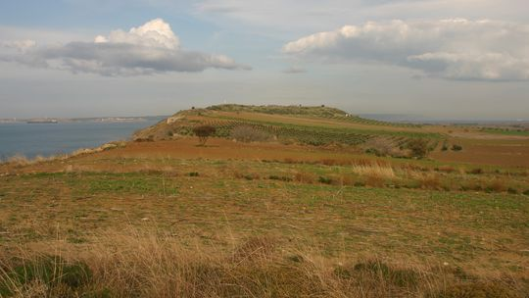
Philostratus, Heroikos
Protesilaus is buried in a garden (like Robert Paulson!)
“This large mound here no doubt contains him. The nymphs created these elms around the mound, and they made, I suppose, the following decree concerning these trees: “Those branches turned toward Ilion [Troy] will blossom early and will then immediately shed their leaves before their season, (this was indeed the misfortune of Protesilaus), but a tree on the other side will live and prosper.” (p. 31)

Slide 24
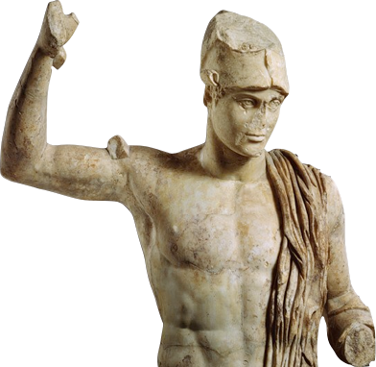
Philostratus, Heroikos
Protesilaus regularly comes back to life in this sacred garden around his tomb.
He practices running and other sports, and he’s real enough to leave footprints and to be embraced.
He gives advice to athletes and young lovers, and helps those afflicted with certain diseases.
When an adulteress and her lover came to his tomb, Protesilaus caused a dog to bite them and chase them away.

Slide 25
Philostratus, Heroikos
“He heals all the illnesses there are, especially consumption, edemas, diseases of the eyes, and quartan fever. Lovers can also gain his counsel, for he sympathizes deeply with those unlucky in erotic matters, and he suggests charms and tricks with which they enchant their boy lovers. But he neither converses with adulterers, nor offers them any erotic advice. He says that he dislikes them because they give love a bad name.” (p. 47)

Slide 26
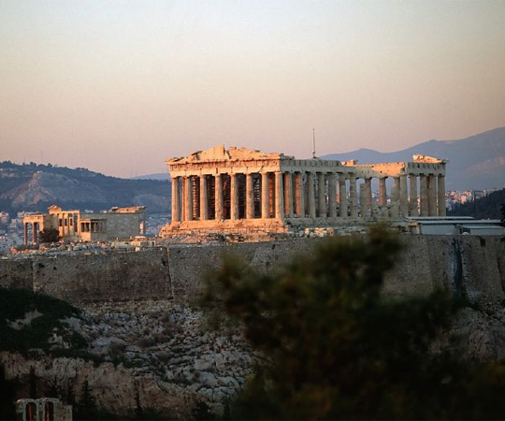
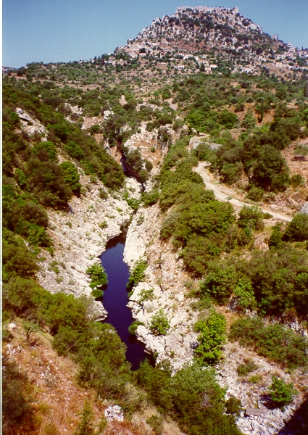
Some Basic Facts about Hero-Cult
It’s deeply local. Every city, every neighborhood, every village, every forest, mountain and stream can have its own hero.

Slide 27
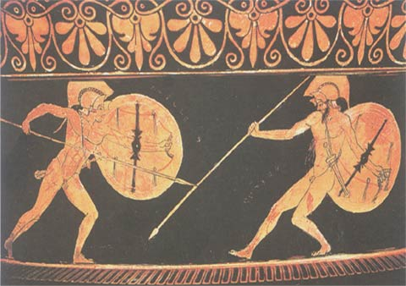
Some Basic Facts about Hero-Cult
2. Every character, male, female, young or old, in Greek literature, is potentially a hero. But there would have been thousands more heroes we don’t know about.

Slide 28
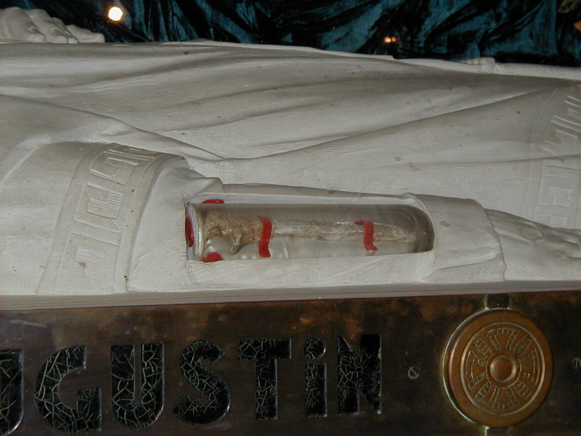
Some Basic Facts about Hero-Cult
3. Hero-cult based around the body of the hero, or parts thereof, buried in the local ground in a tomb that could be well-known or secret.
Elbow of St. Augustine
of Hippo

Slide 29
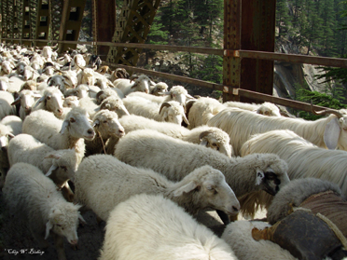
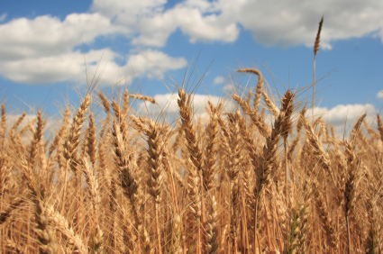
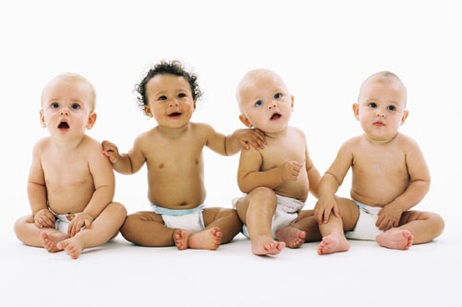
Some Basic Facts about Hero-Cult
4. The hero and his tomb provided fertility and prosperity to its community.

Slide 30
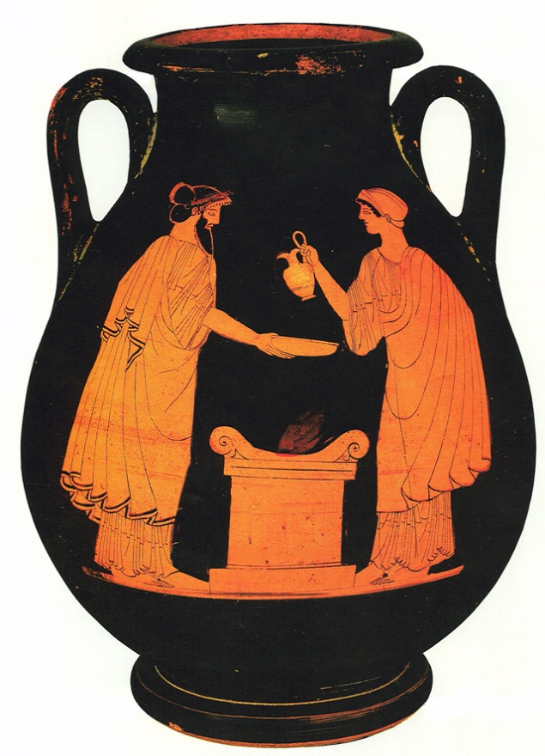
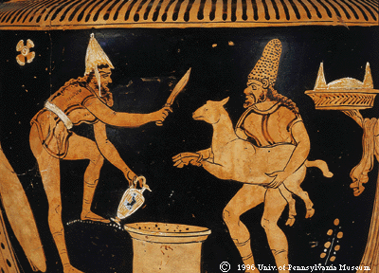
Some Basic Facts about Hero-Cult
Heroes are worshipped, kept happy, and brought back to life through animal sacrifice (often a ram, usually into a pit), and through libations (ritual offerings of liquid poured into the ground).

Slide 31
Some Basic Facts about Hero-Cult
What goes wrong in myth is what (we hope) will go right because of ritual.

Slide 32
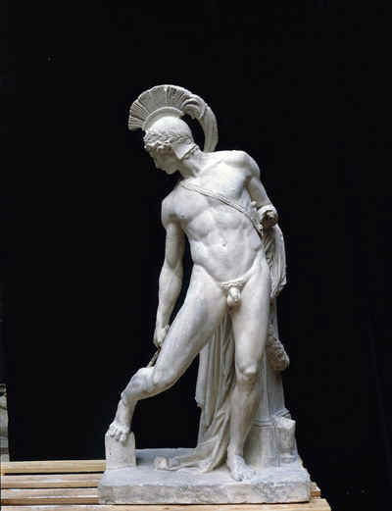
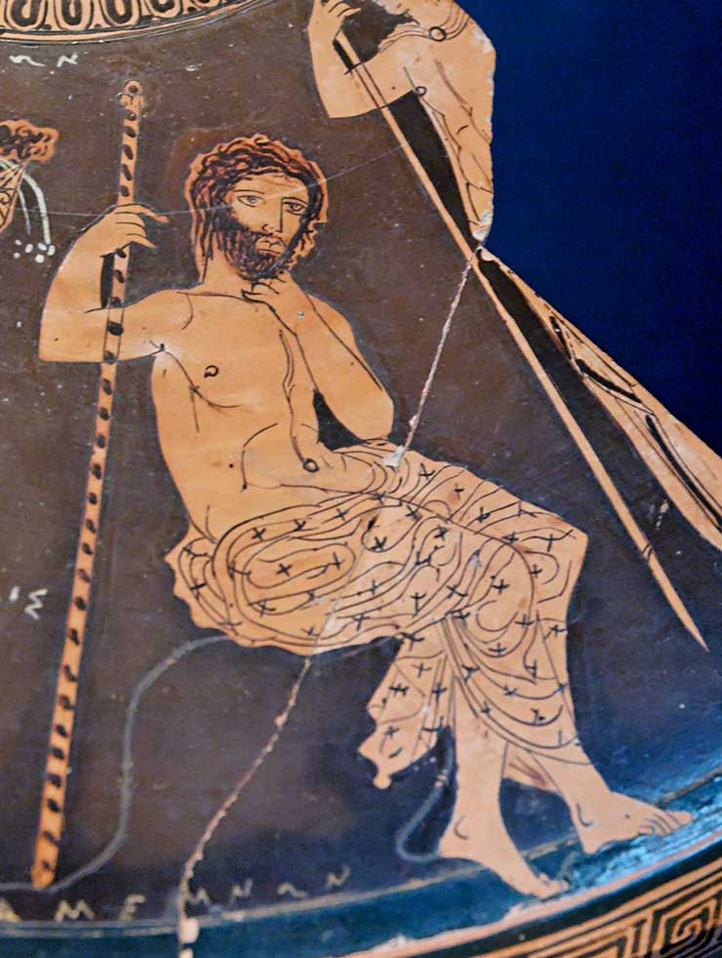
Major Heroes of the Iliad
Achilles
Agamemnon

Slide 33
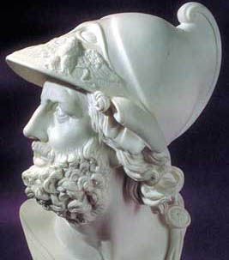
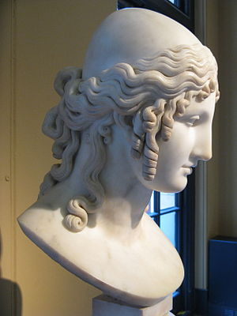
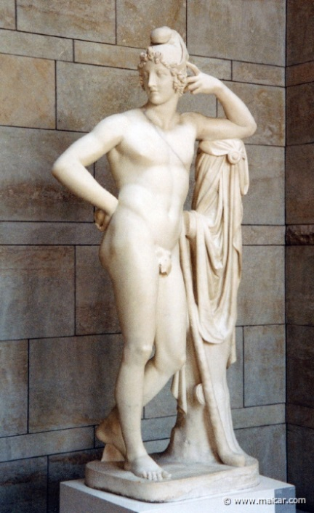
Major Heroes of the Iliad
Menelaus
Helen
Paris

Slide 34
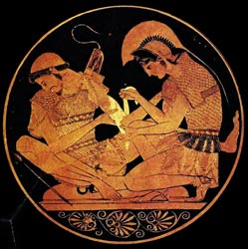
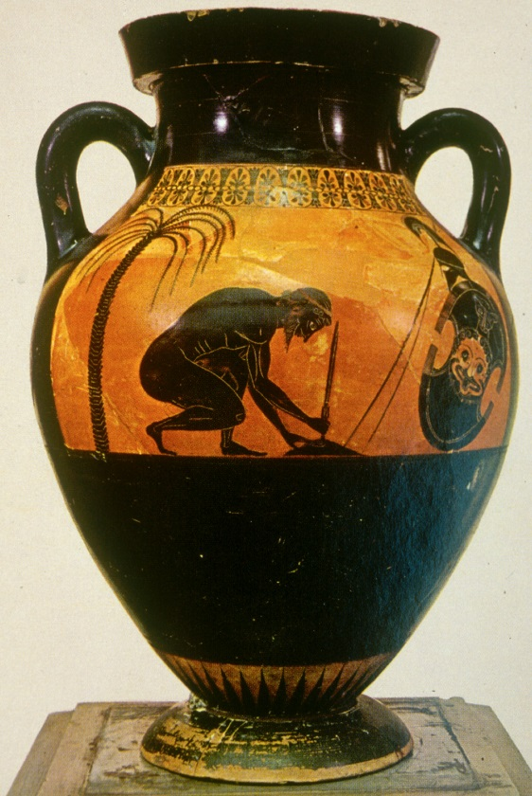
Major Heroes of the Iliad

Slide 35
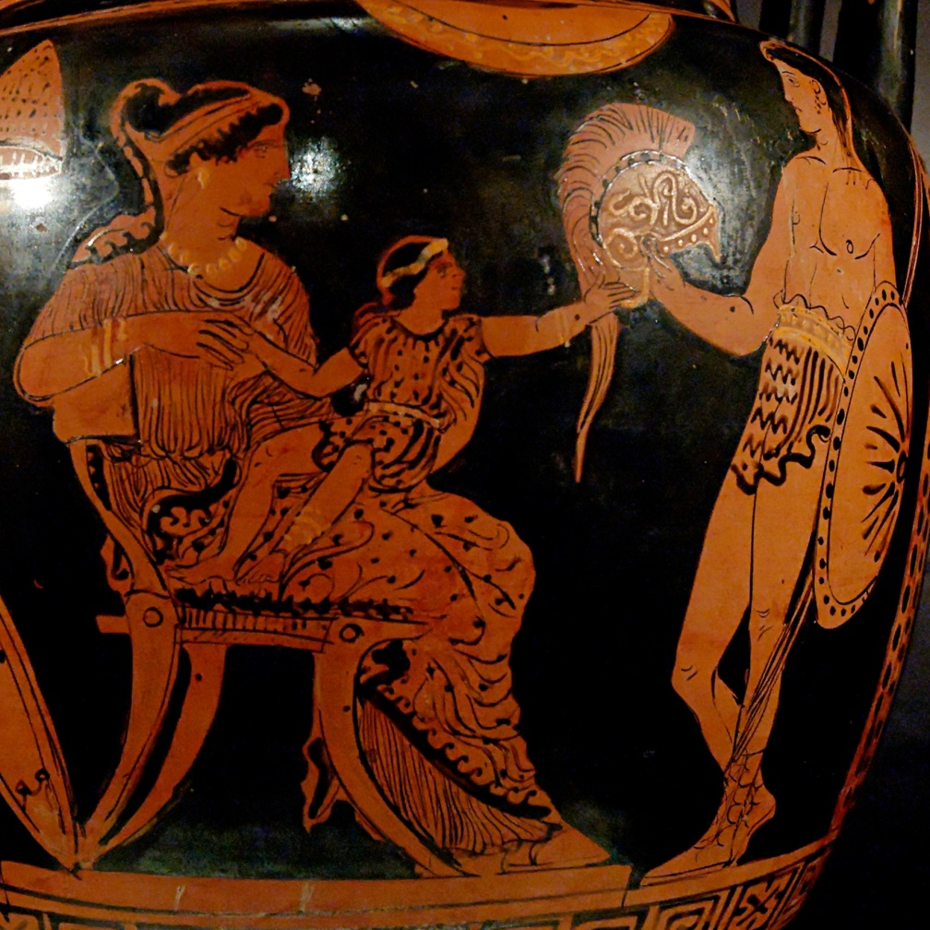
Major Heroes of the Iliad
Hector and Andromache

Slide 36
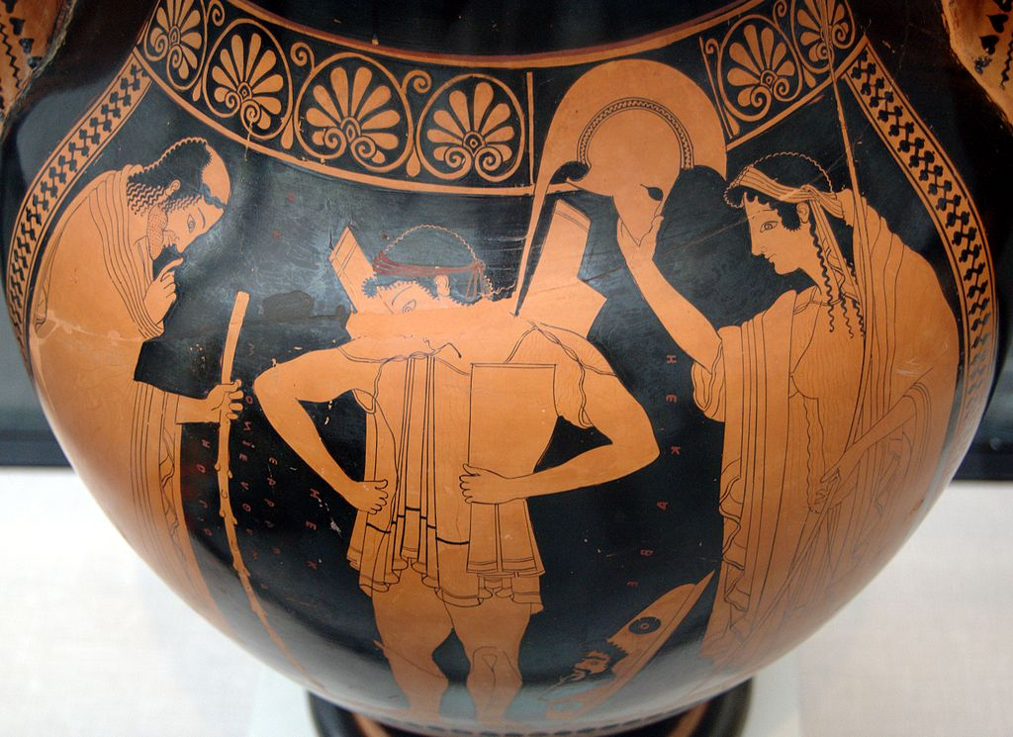
Major Heroes of the Iliad
Priam and Hecuba

